Slide 1
HEDGEHOGS
By Freya and Sophia

Slide 2
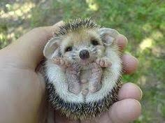
Hoglets
When hoglets are born they cannot open their until they are older.
The hoglets drink their mother's milk until they are five weeks old.

Slide 3
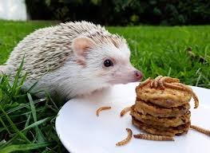
DANGEROUS THINGS FOR HEDGEHOGS
Many people think they should leave milk and bread out for hedgehogs but it can be very dangerous for them.
Litter can be dangerous for them as well as some food.

Slide 4
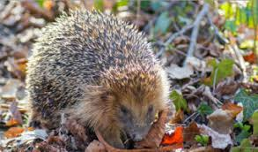
GROWN UP HEDGEHOGS
Unlike some nocturnal animal hedgehogs see poorly at night They use their whiskers to feel their way home.

Slide 5
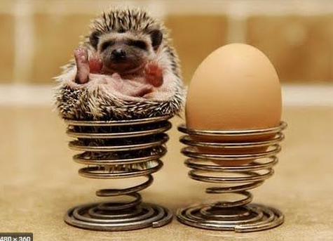
DID YOU KNOW
Did you know hedgehogs munch on almost any thing inclooding birds eggs and insecs.

